Slide 1

House Price Prediction
Submitted by
Fazal Ahamed

Slide 2
INTRODUCTION
The House price prediction dataset is Given in csv format for predicting the House price.
The entire data consists os 1167 rows and 81 columns.
There are various factors that will come into picture while predicting the House price.
Building a ML model with many columns is always a challenging one.
Lets get started......!

Slide 3
Analysis
Loading the dataset into Python (jupyter notebook)
Then checking for various items such as columns, rows, info, describe,shape etc etc to gain some information from the dataset.
Start performing Univariate , Bi variate and multi variate analysis to gain some insights how the data is realted to each others.

Slide 4
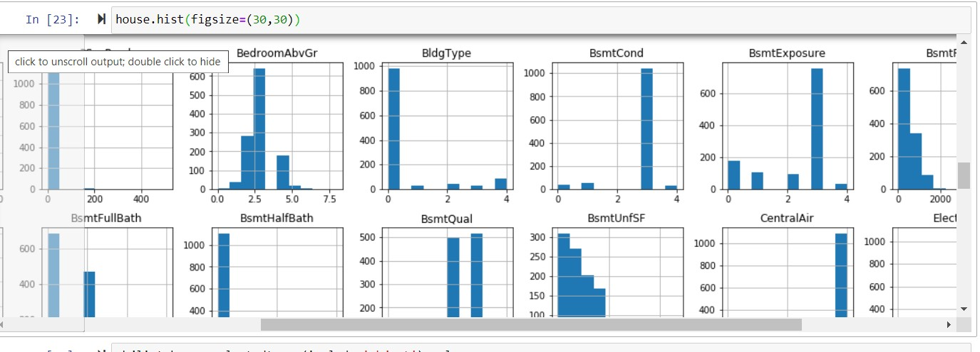
Univariate Analysis
This is the sample of Univariate graph

Slide 5
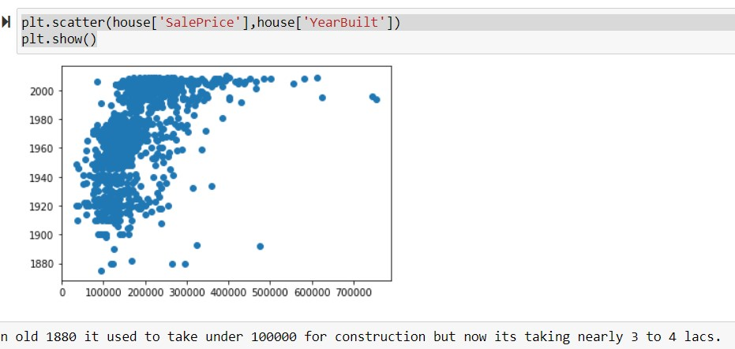
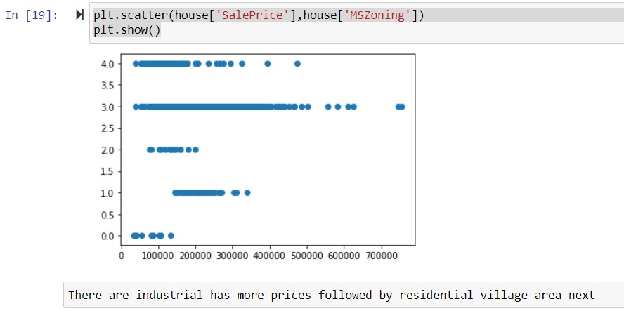
Bi Variate Analysis
Bi variate graph samples.

Slide 6
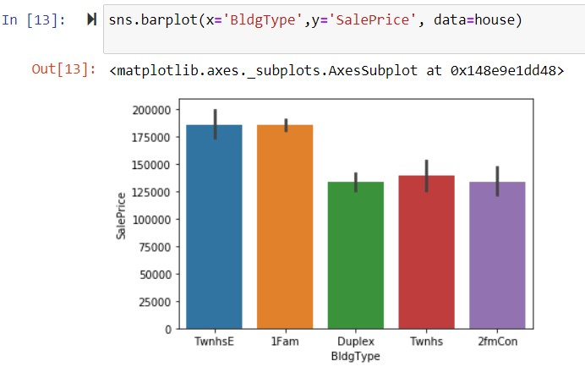
Data analysis of building type

Slide 7
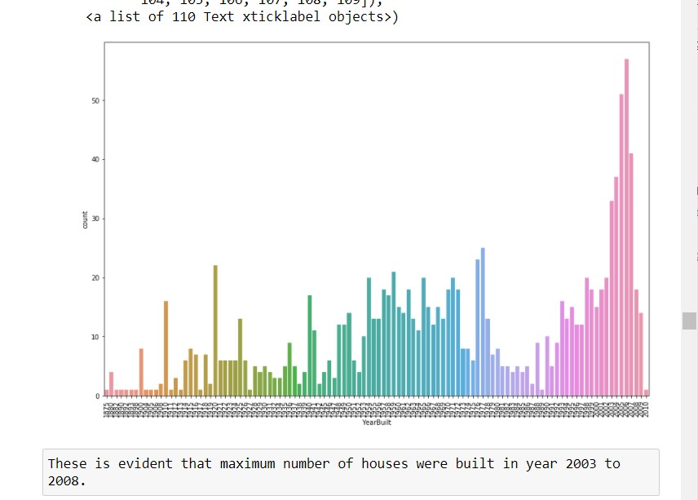
Maximum number of houses were built in year 2003 to 2008

Slide 8
Once done with analysis we will check for outliers and skewness removal
Converting all the object data into int or float by using Label encoder.
later using yeo-johnson method , i have treated skewness removal.
Once done with all above steps , started to build a ML model .
Separating training and testing data set.
Then assigning x and y variables . later Applying it to a model for prediction

Slide 9
As the accuracy was 84%, it was a good price prediction model.
Hence saved the model with job pickle.

